Slide 1

Mountaineer
The D is silent.

Slide 2
Problem
Existing Apps are not designed for moutain climbers
They miss some important information:
Covered altitude
Time spent walking uphill/downhill
Calculation of calories

Slide 3
Solution

Slide 4
Solution
Android App
Specialized for Mountaineers

Slide 5
Functionality
Add tours/trips
Monitor weather and health information
Display details of completed tours
Tracking of altitude
Subject to change without prior notice.

Slide 6
What kind of Details?
General information
Track/Route details
Weather information
Health
Subject to change without prior notice.

Slide 7
Technical Stuff
Firebase
For Training Units
Used for Fast-Prototyping
Dedicated Database on Webserver for Production
More Details coming soon ;)
Subject to change without prior notice.

Slide 8
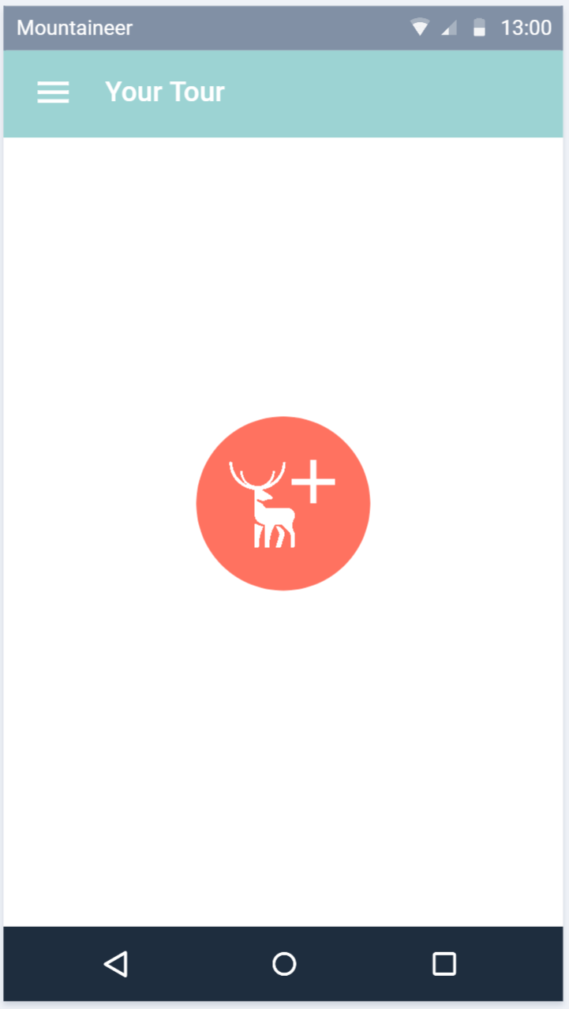
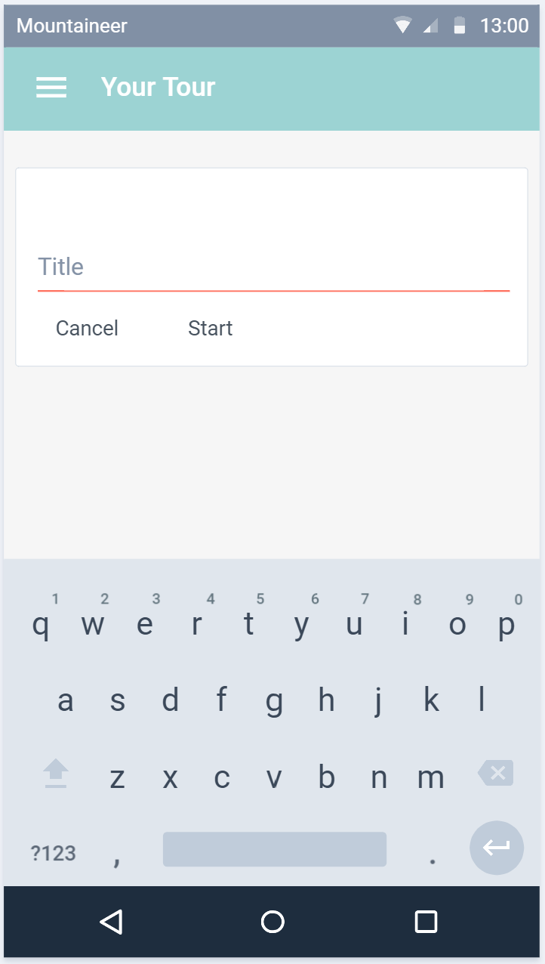
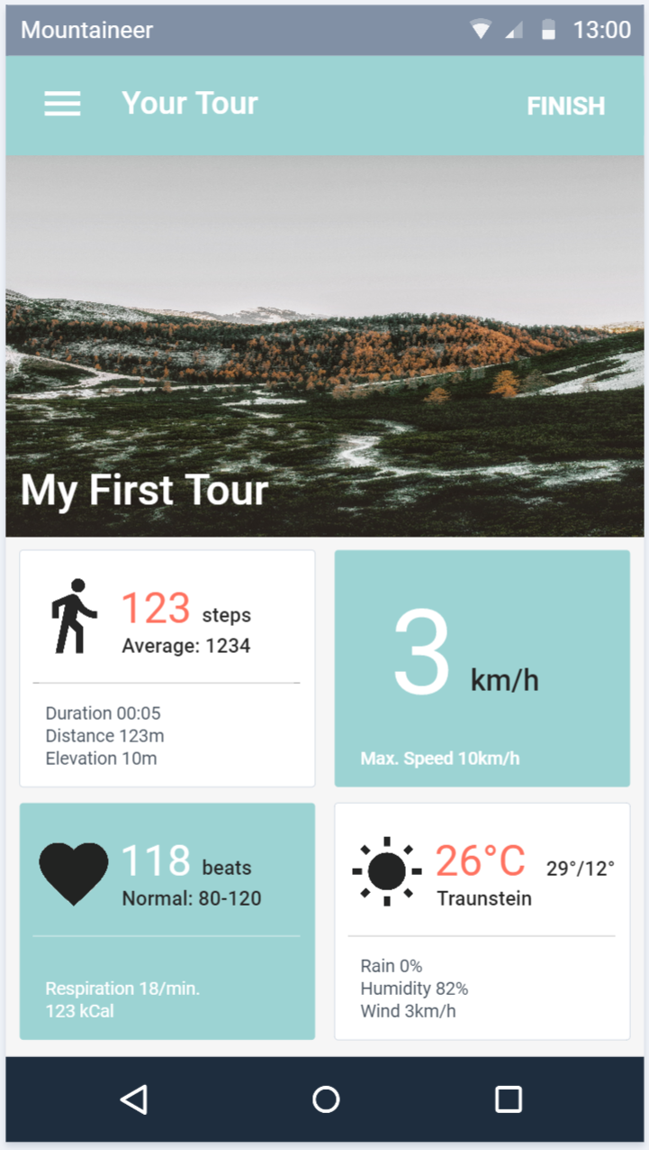
Planned Design
Subject to change without prior notice.

Slide 9
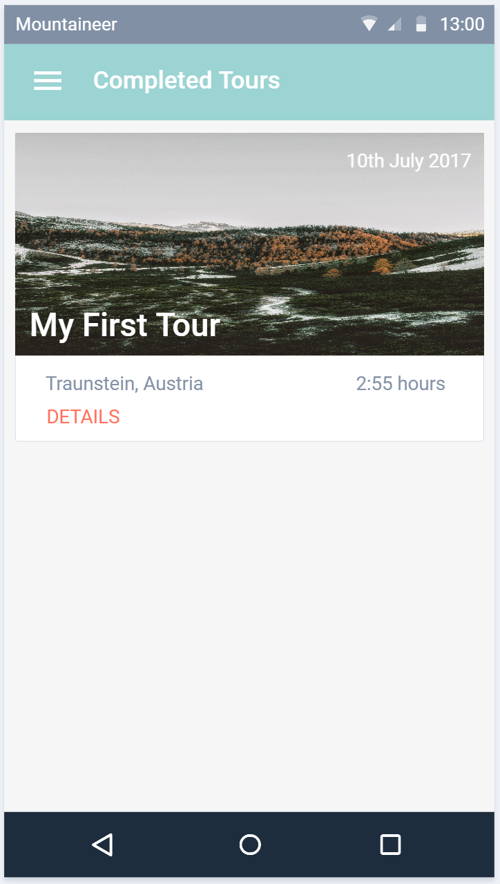
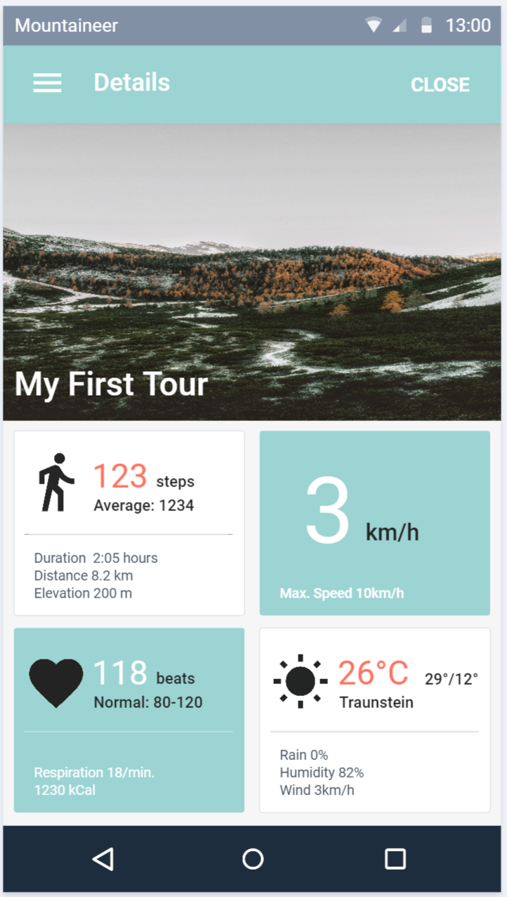
Planned Design
Subject to change without prior notice.

Slide 10
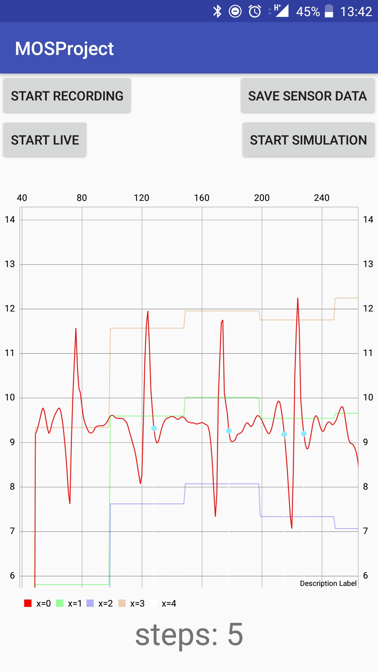
Pedometer
Simulation + Live-View
Graph
Used for debugging and testing
Firebase
Running as a Service
Implemented according to the PDF
But with little parameter adjustments

Slide 11
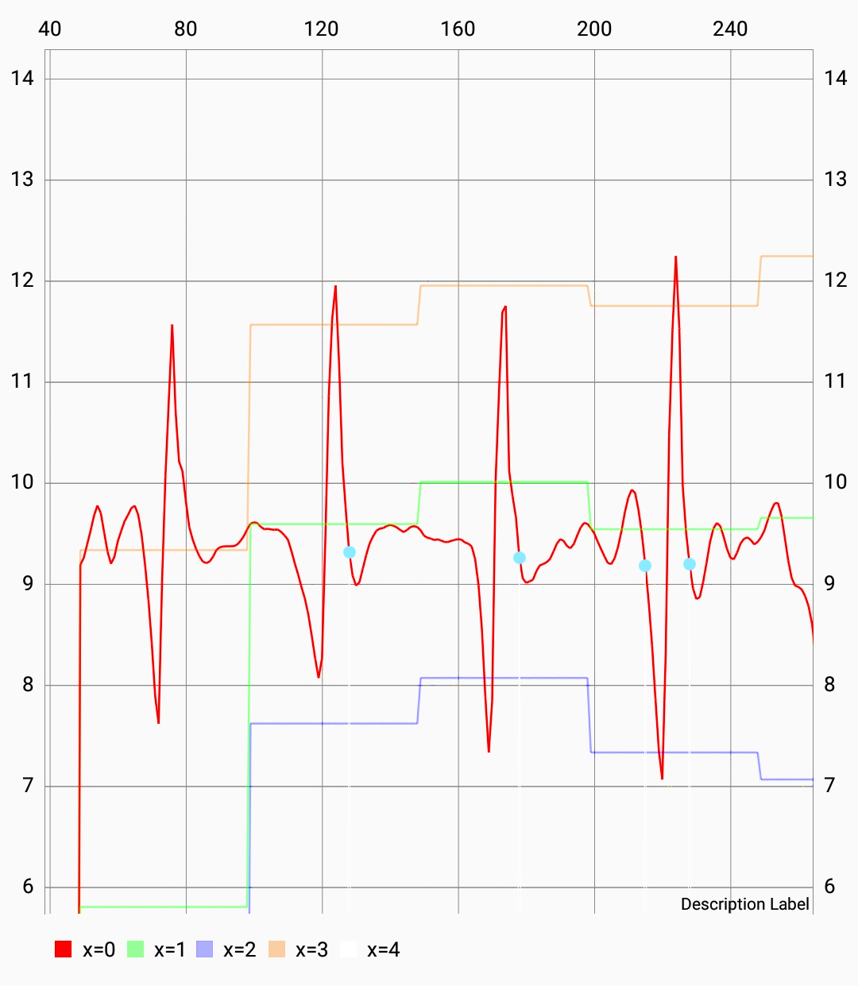
Chart Details
Measured values
Max + Min
Threshold
Detected steps

Slide 12
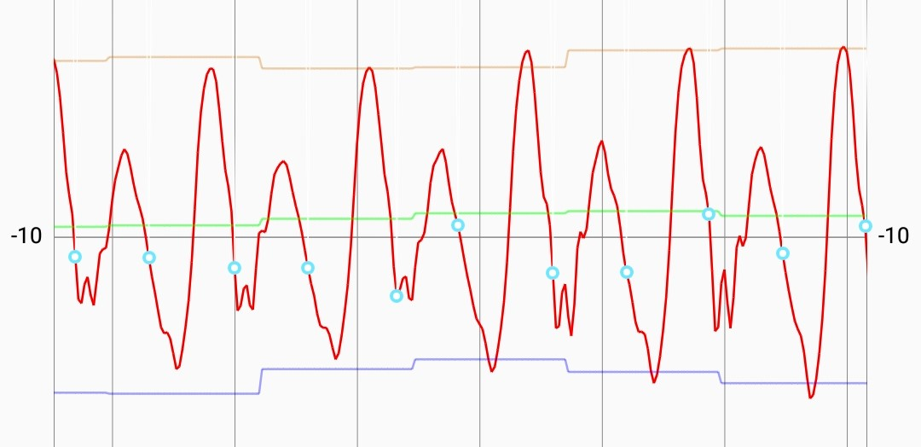
Acceleration of morning walk to FH

Slide 13
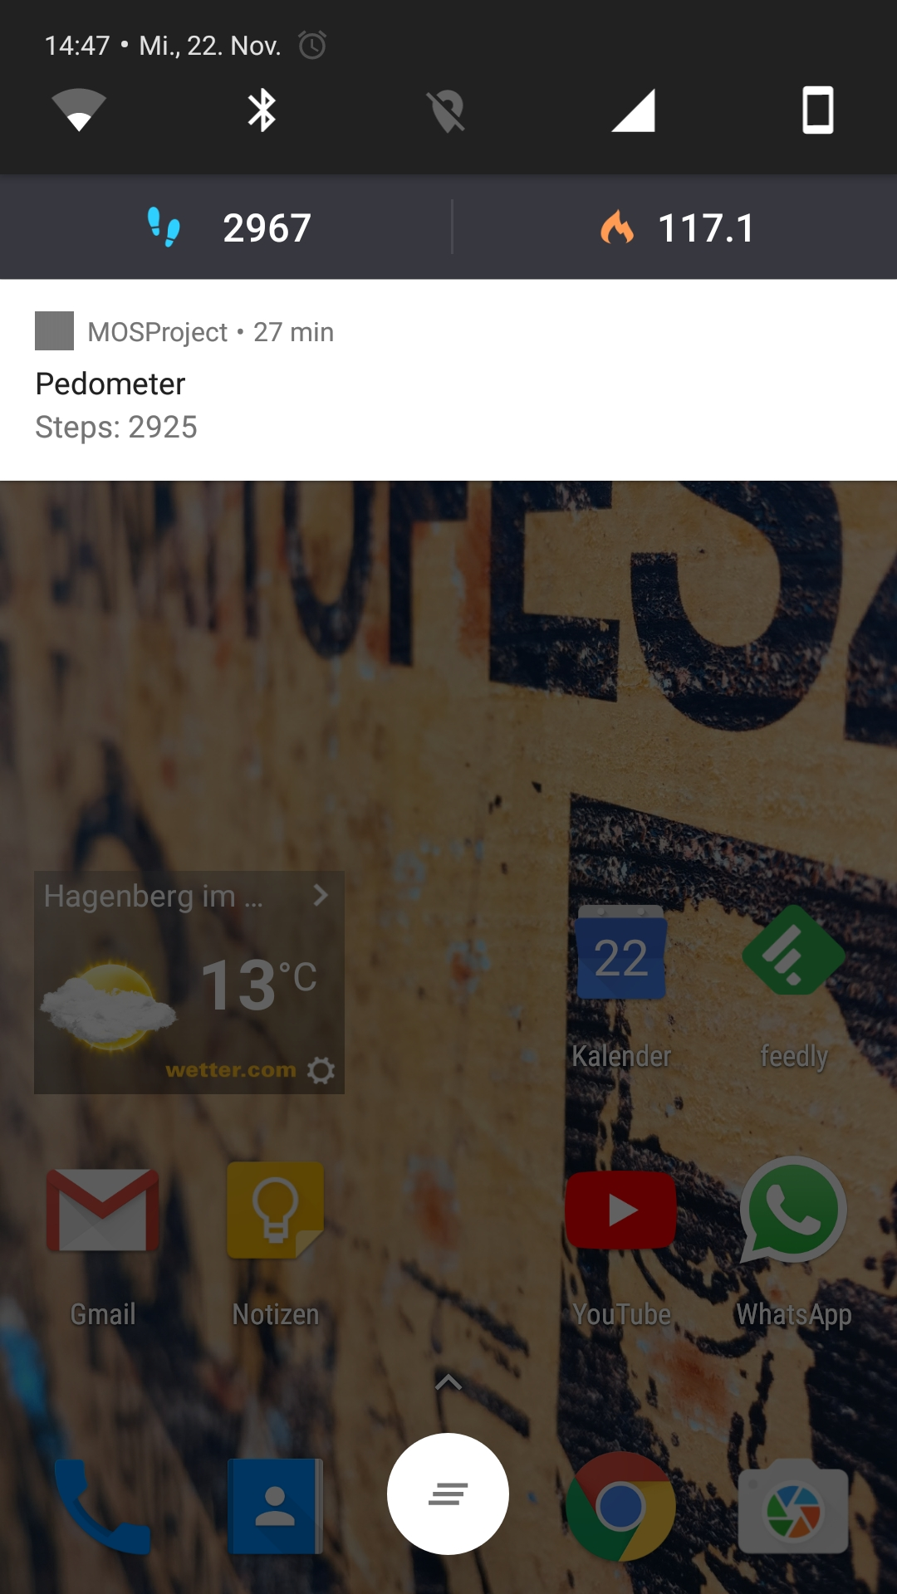
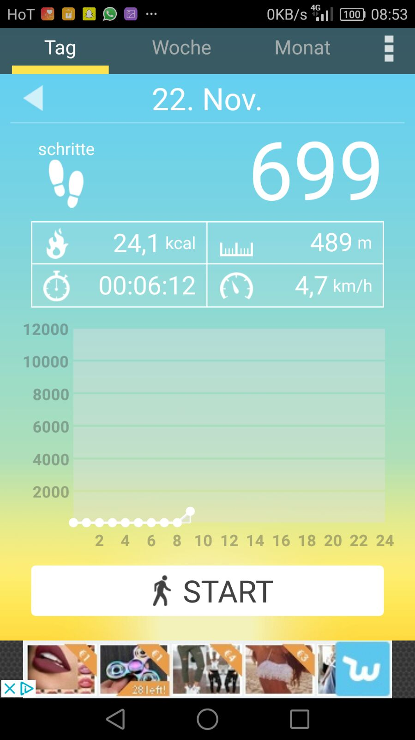
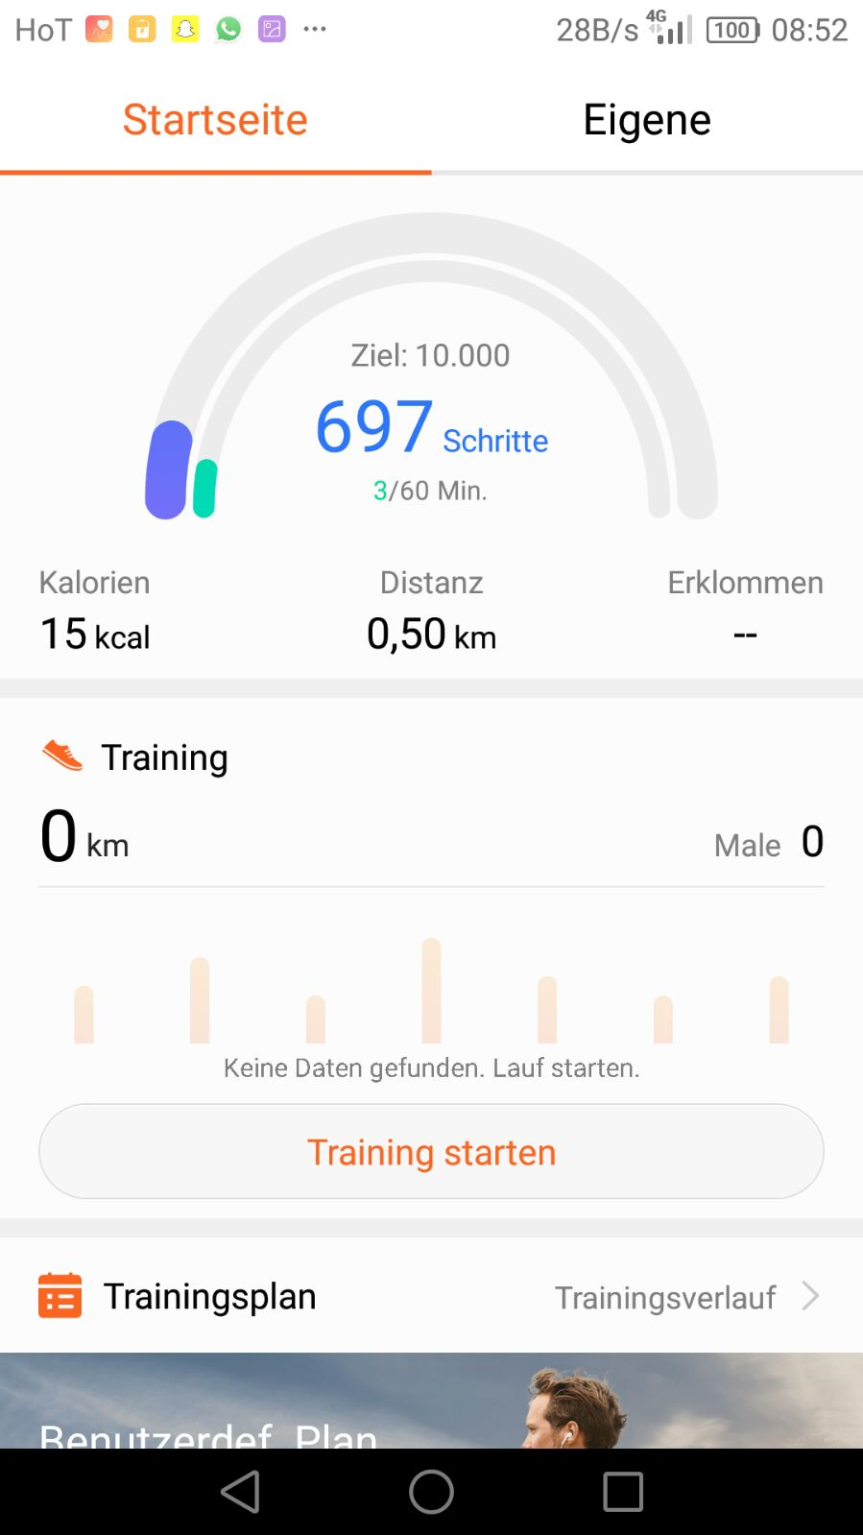
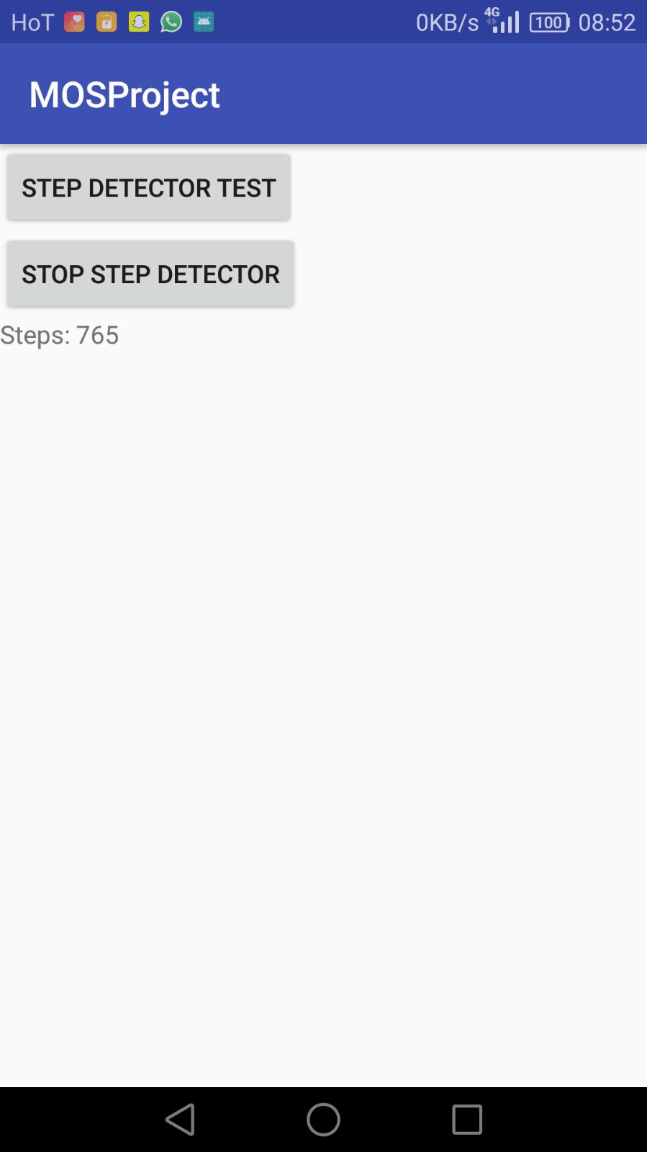
Competition Analysis
Accuracy compared to:
Pedometer
Huawei Health
Schrittzähler

Slide 14
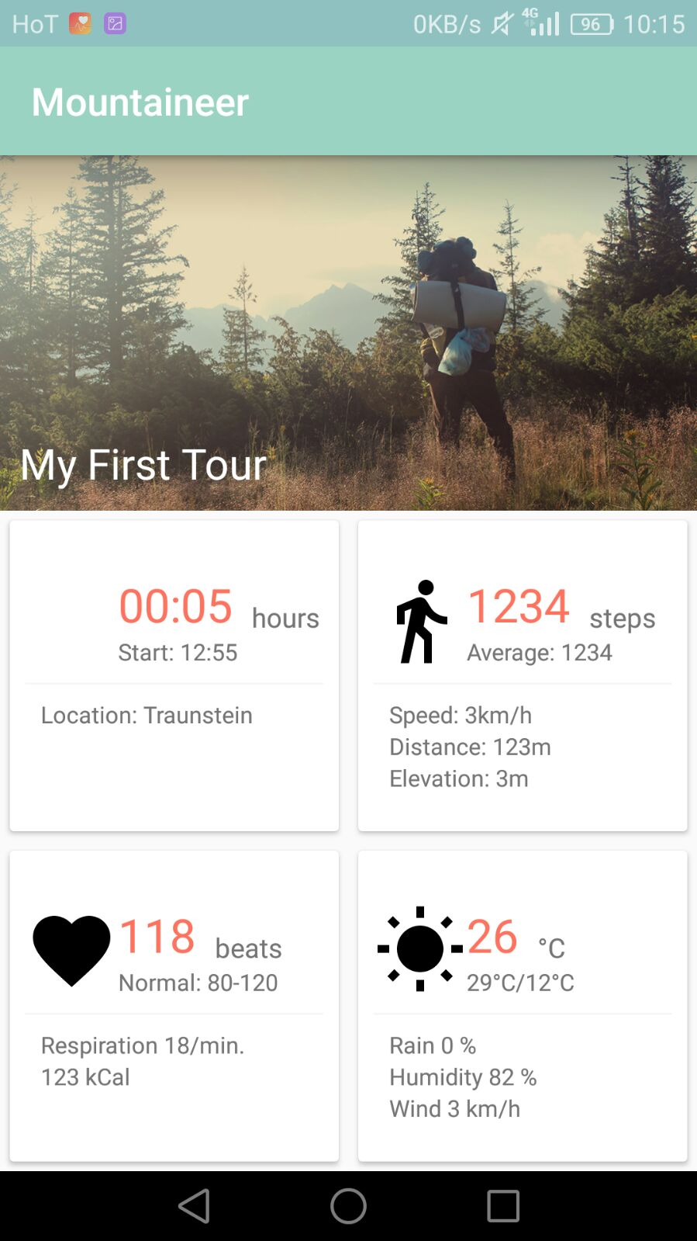
UI is (almost) ready
and waiting for functionality

Slide 15
Thanks!

Slide 16
Mountaineer
An Update.

Slide 17
Heart Rate Monitoring #1
Simulation of Heartrate Sensor
Bluetooth LE connection
Calculate
Fitness
Fatigue
Performance

Slide 18
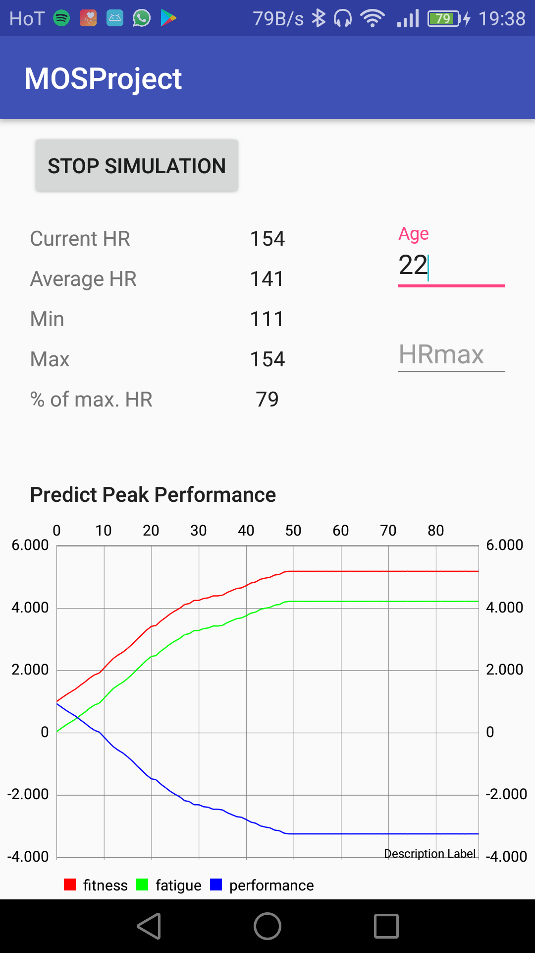
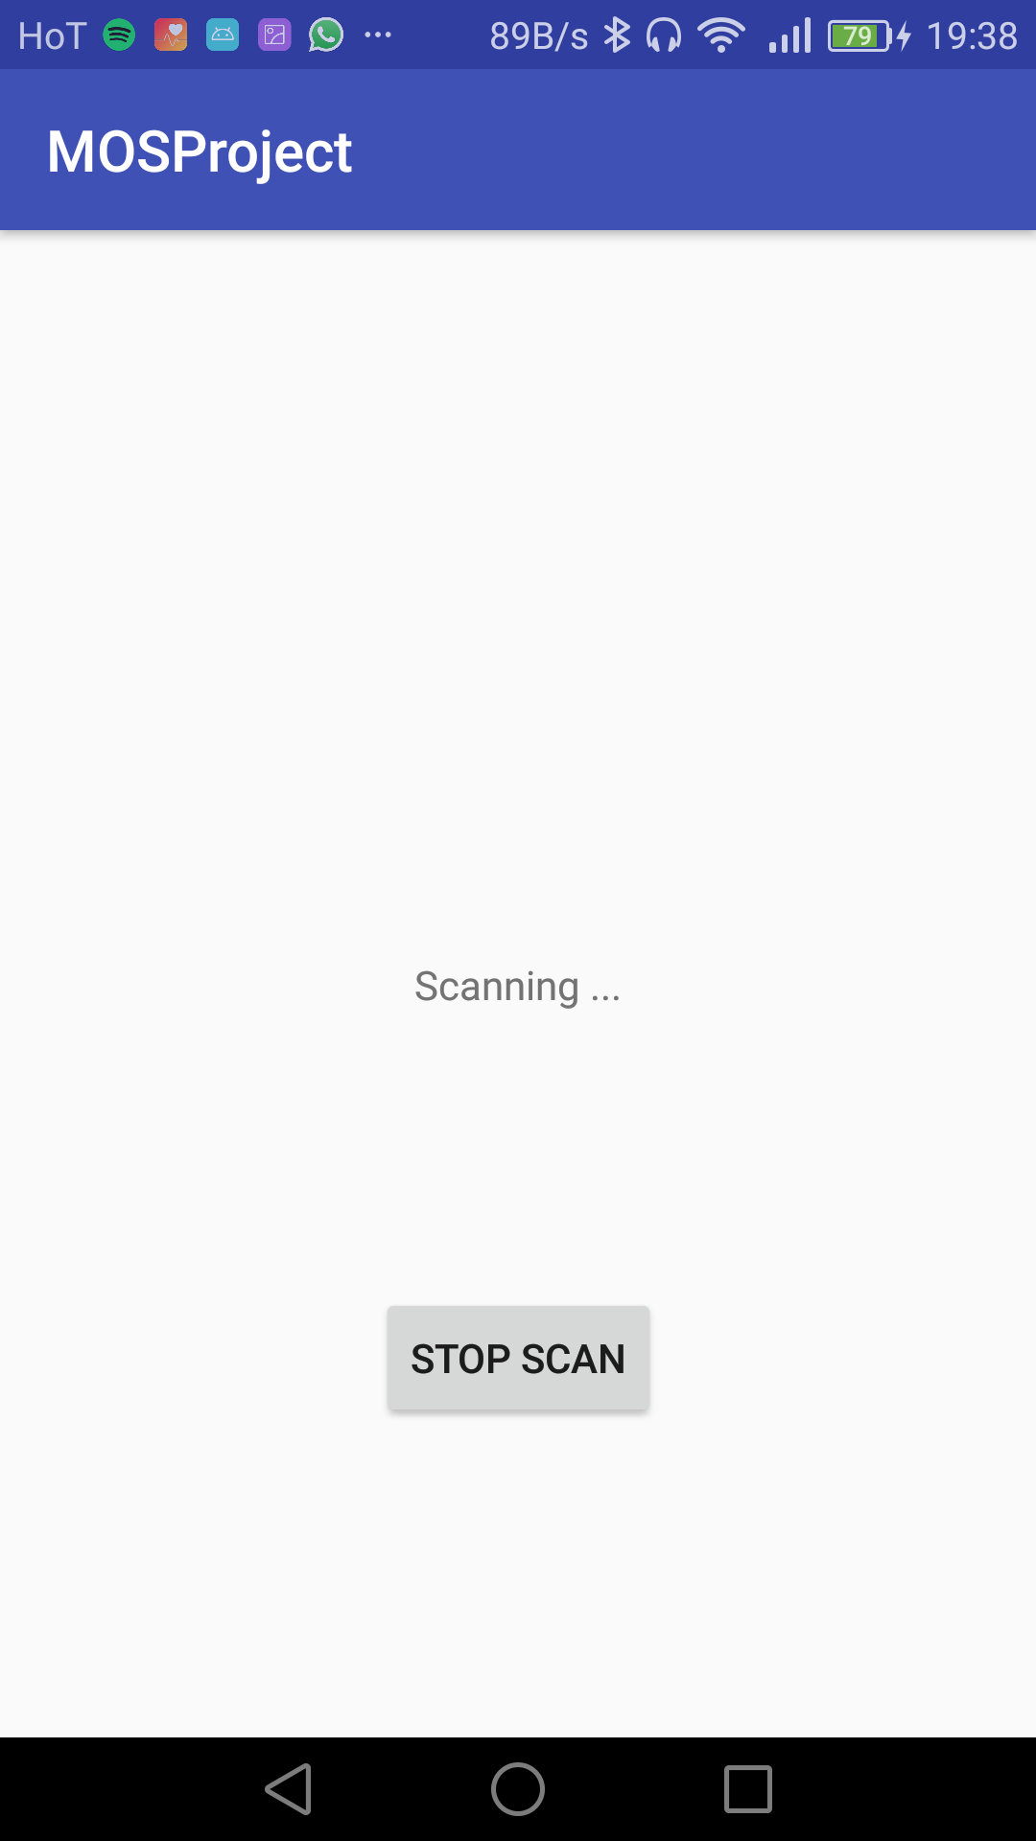
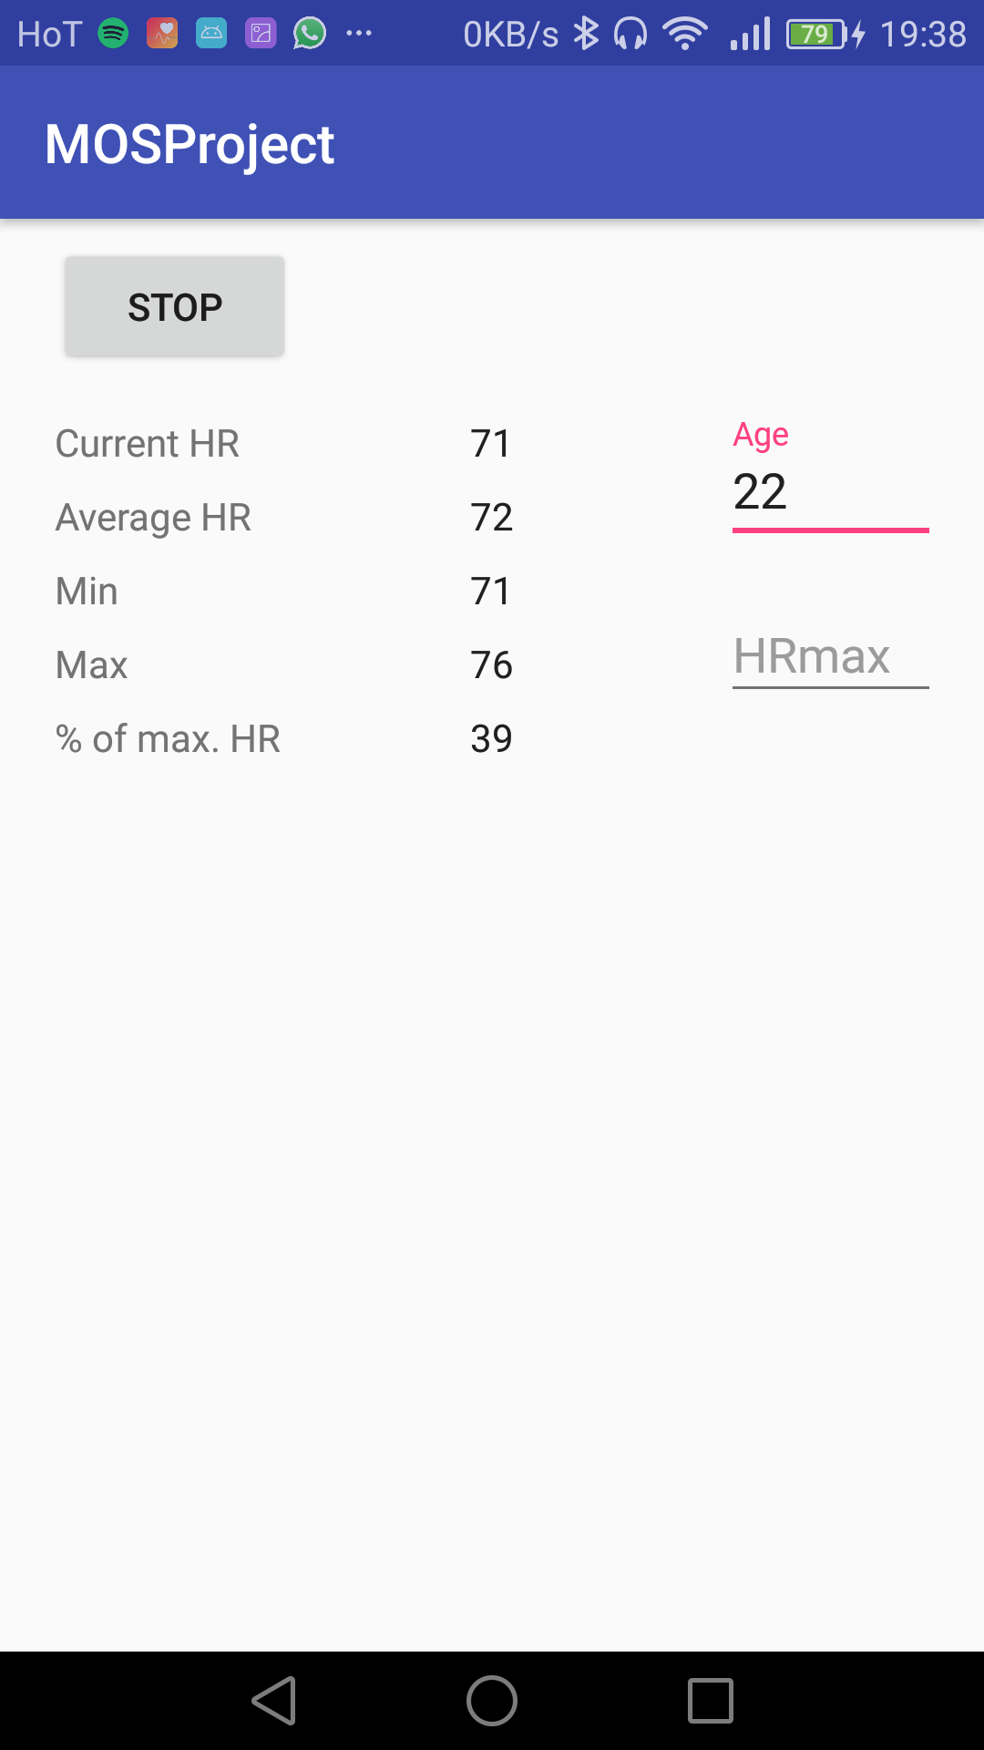
Heart Rate Monitoring #2

Slide 19
Heart Rate Monitoring #3

Slide 20
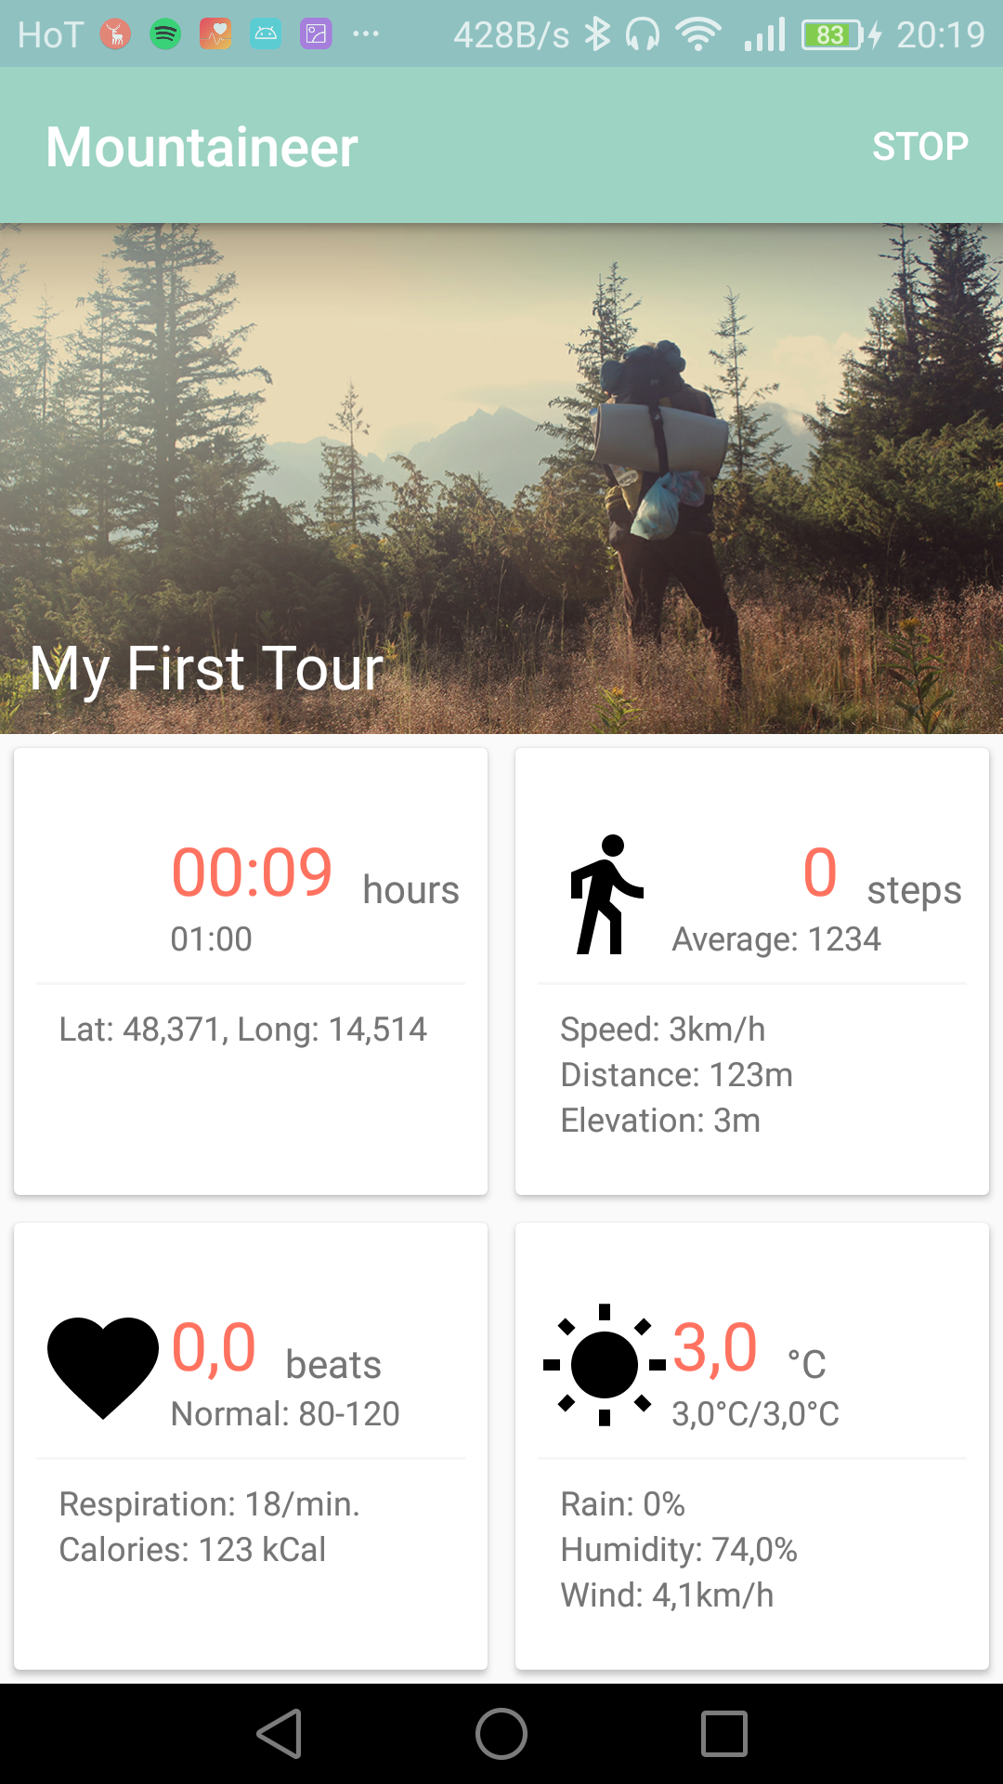
Android App #1

Slide 21
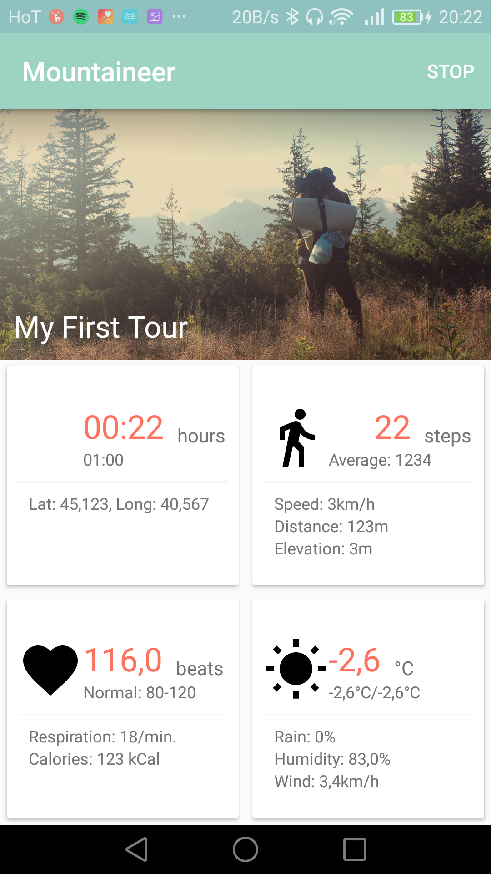
Android App #2

Slide 22
Android App #3

Slide 23
Android App #4

Slide 24
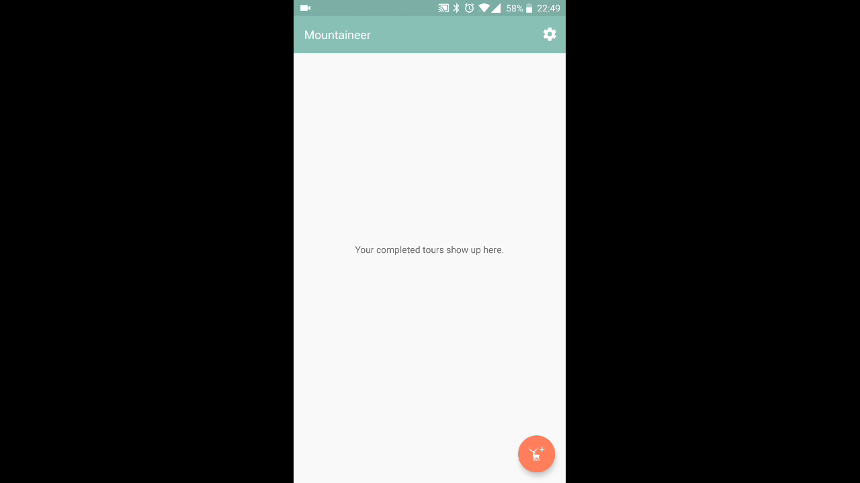
Android App #5
UI
Second Implementation

Slide 25
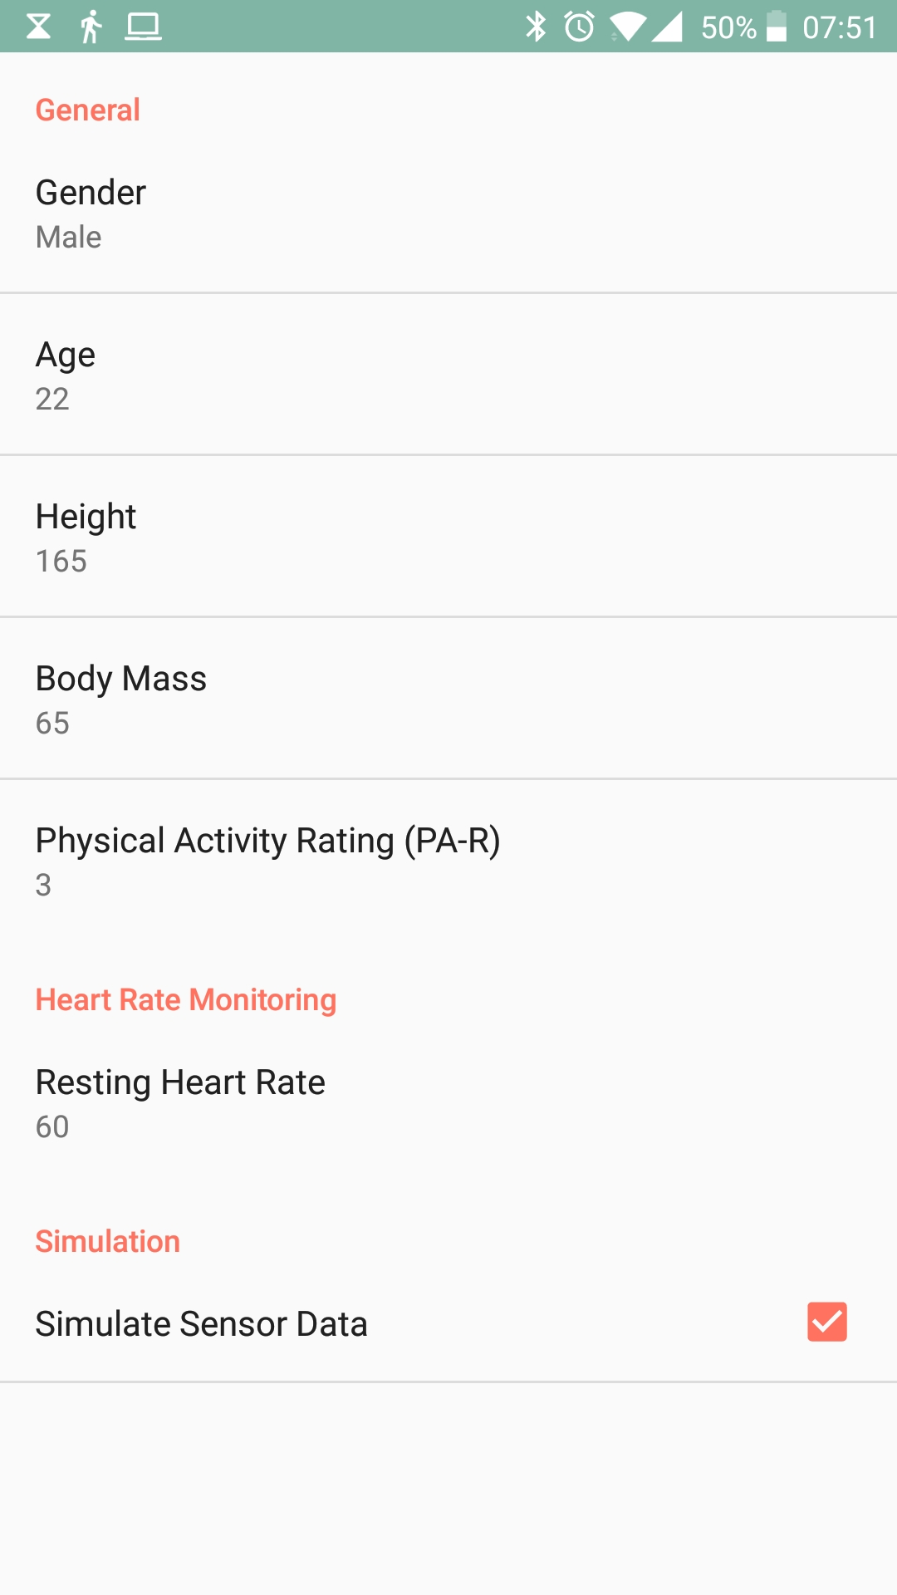
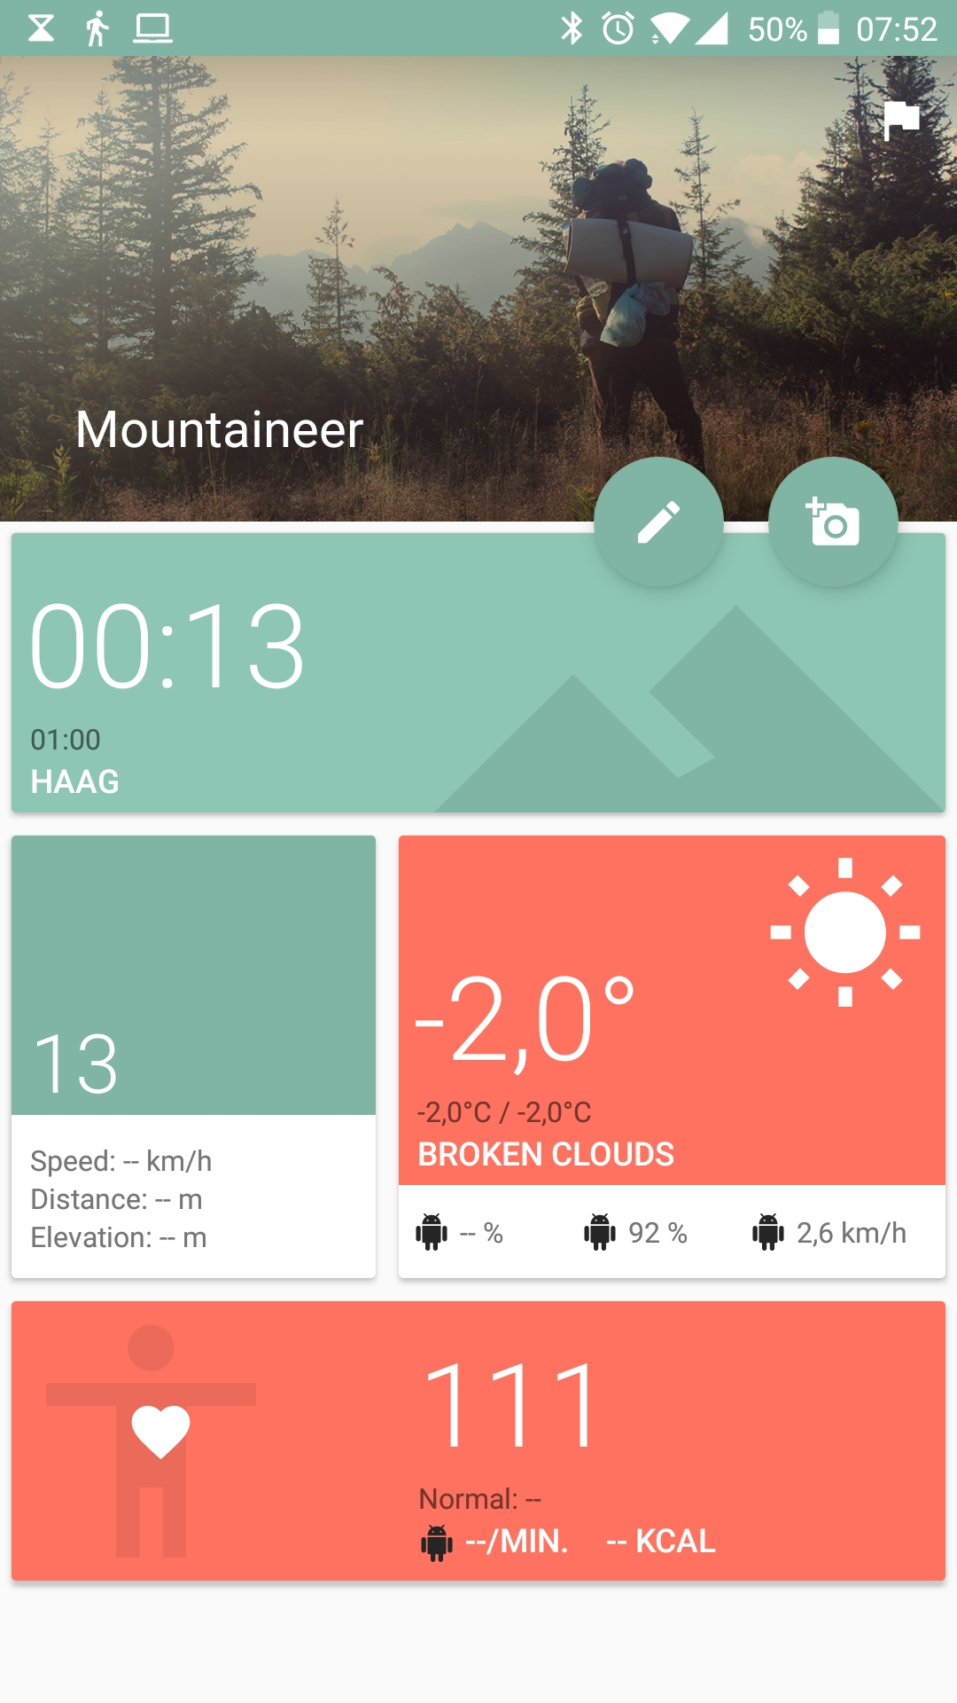
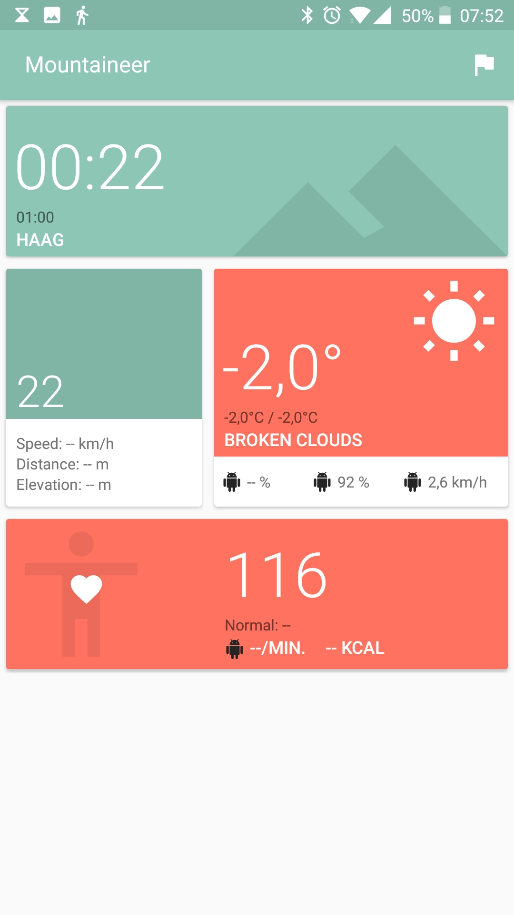
Android App #6

Slide 26
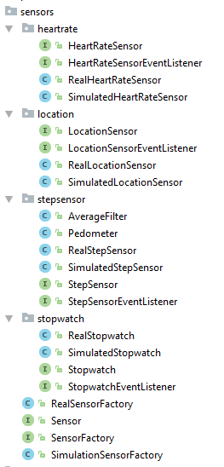
And in the code…
Basically refactored everything
Factory Pattern
Simulation for all sensors
Dependencies
Firebase
AndroidAnnotations
Retrofit
EventBus

Slide 27
And in the code…
Check all the permissions!
Kotlin?

Slide 28
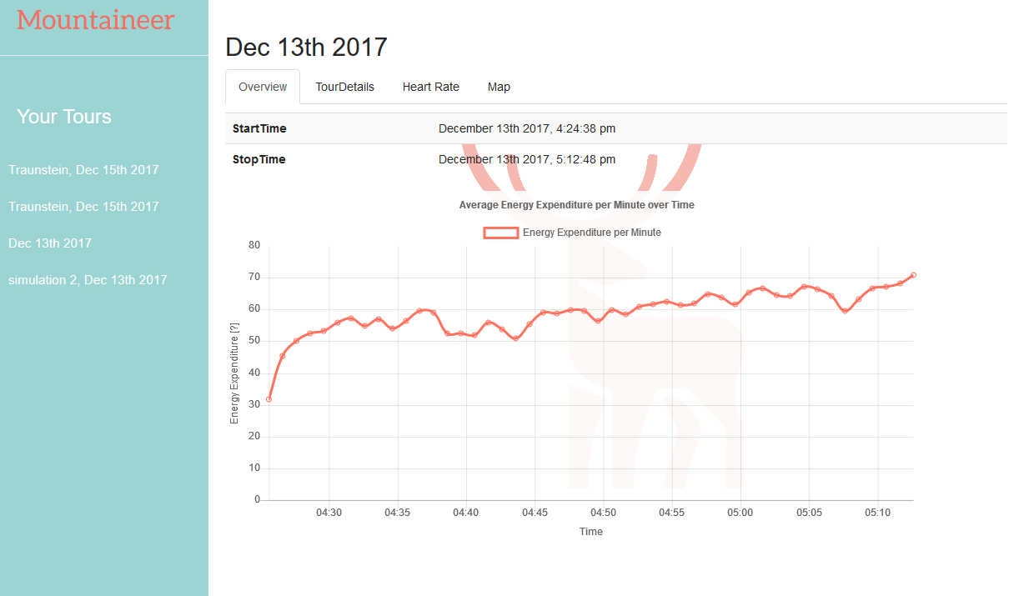
Website #1 Energy Expenditure

Slide 29
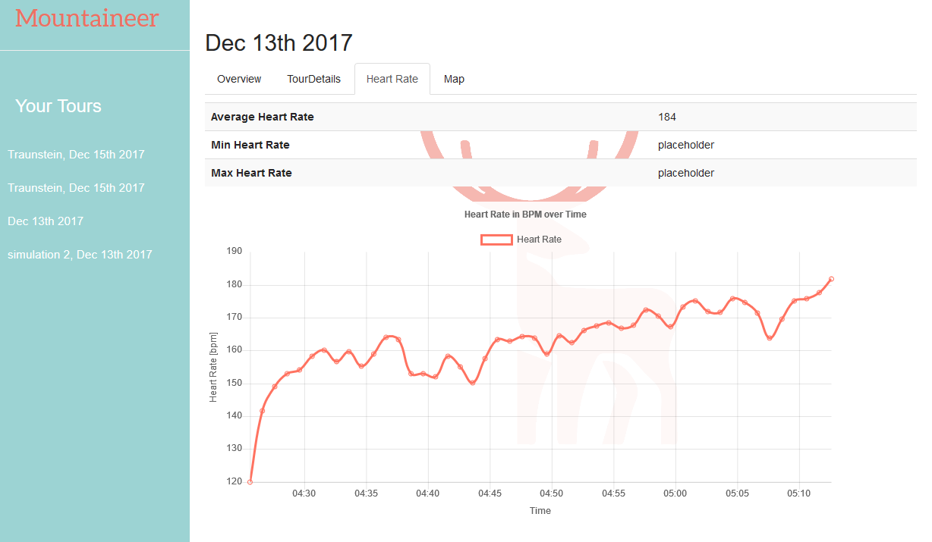
Website #2 Heart Rate

Slide 30
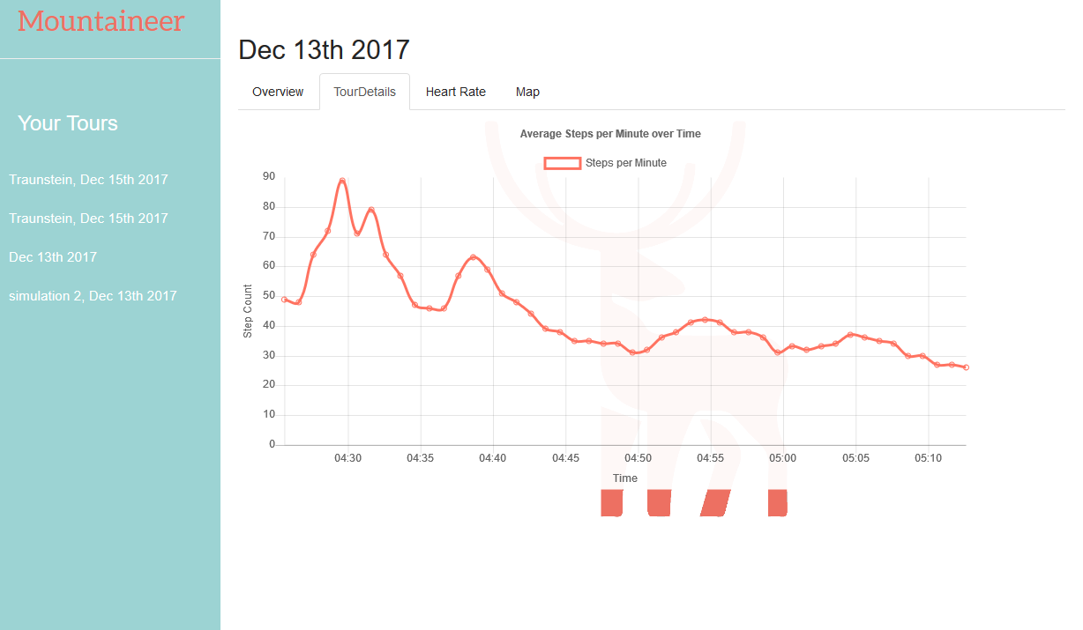
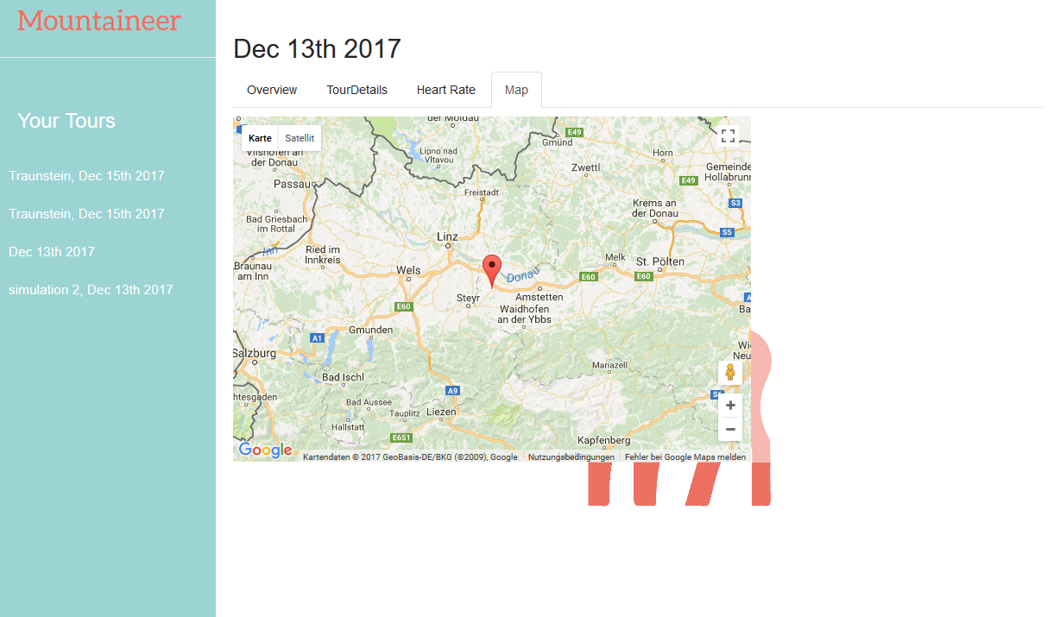
Website #3 Step Count, Map

Slide 31
Website #4
Single Page
Everything in JavaScript
jQuery - why not?
bootstrap - UI components
doT.js - template engine
firebase.js - database api
chart.js - charts
moment.js - date/dime library

Slide 32
Thanks!

